Slide 1

AI-Powered Plagiarism Detection System
Using Sentence-BERT for Semantic Similarity Analysis
Detecting paraphrased content through advanced natural language processing and transformer-based embeddings
Course: Information Retrieval
Presented by: Siddharth Kenia (1350355), Manthan Maru(1354631)
Professor: Houwei Cao

Slide 2
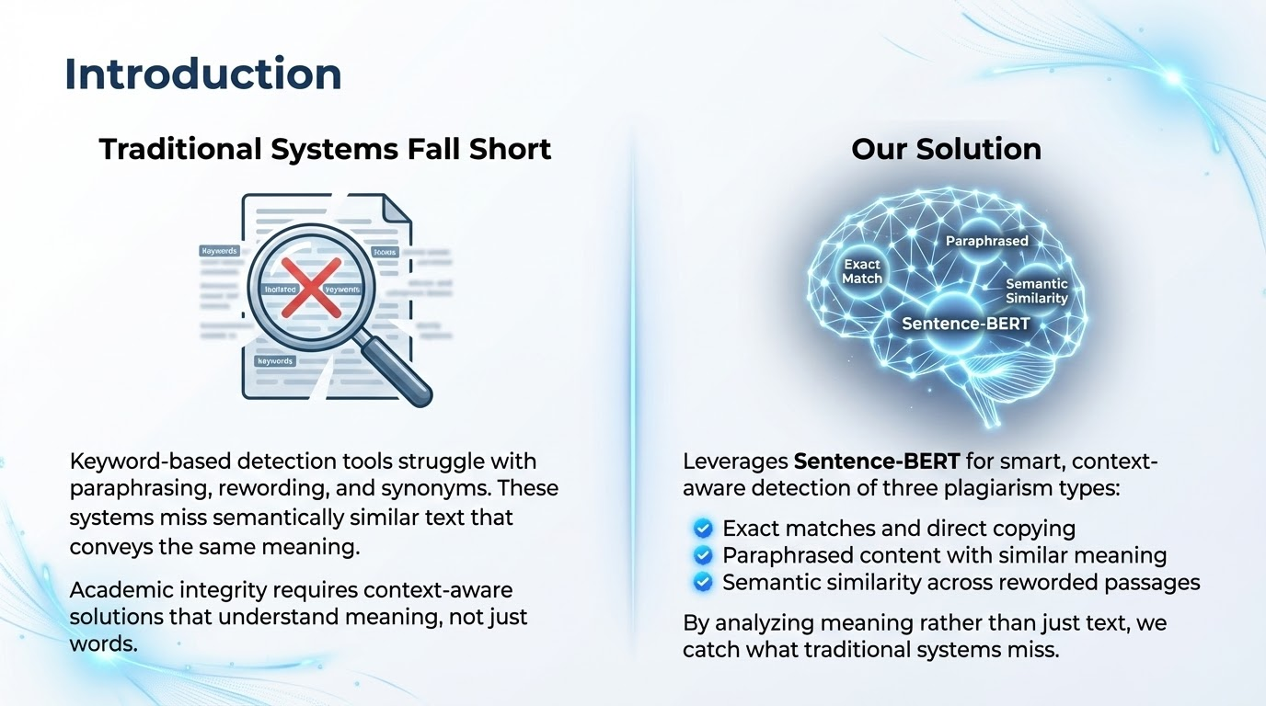

Slide 3
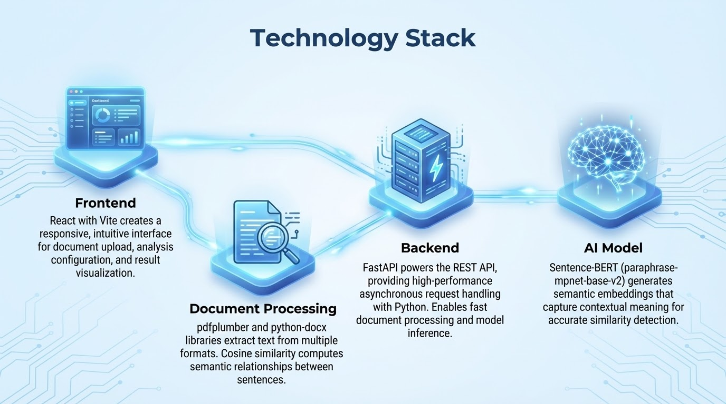

Slide 4





How Sentence-BERT Works
Input Text
Documents are processed and split into individual sentences for granular analysis
Semantic Embeddings
BERT-based transformer generates vector representations capturing contextual meaning
Similarity Matrix
Cosine similarity computed between all sentence pairs from both documents
Classification
Threshold-based detection identifies exact matches and paraphrased content
Unlike traditional systems that match keywords, Sentence-BERT captures the actual meaning of text. This allows detection of paraphrasing where words change but ideas remain identical.

Slide 5
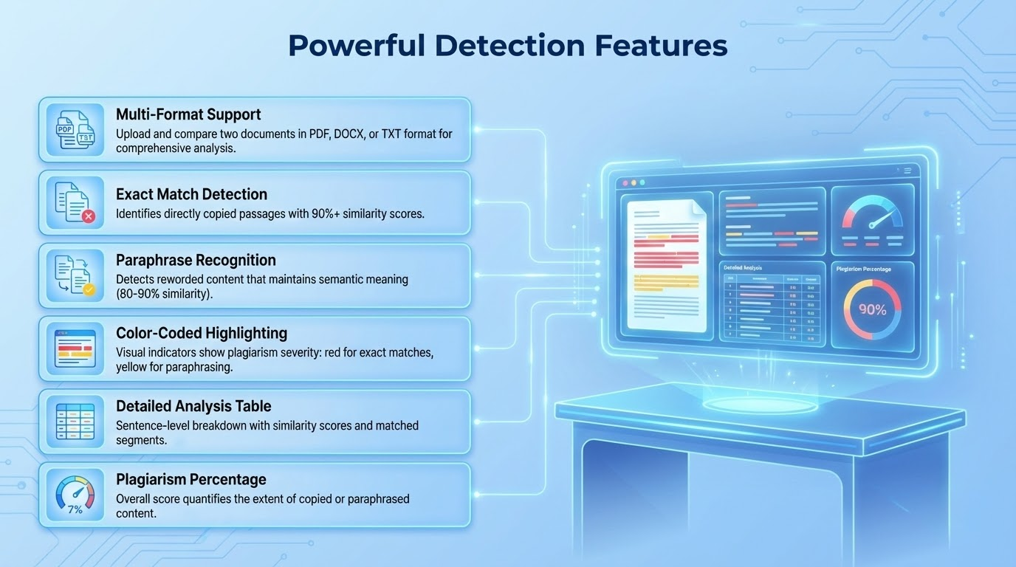

Slide 6
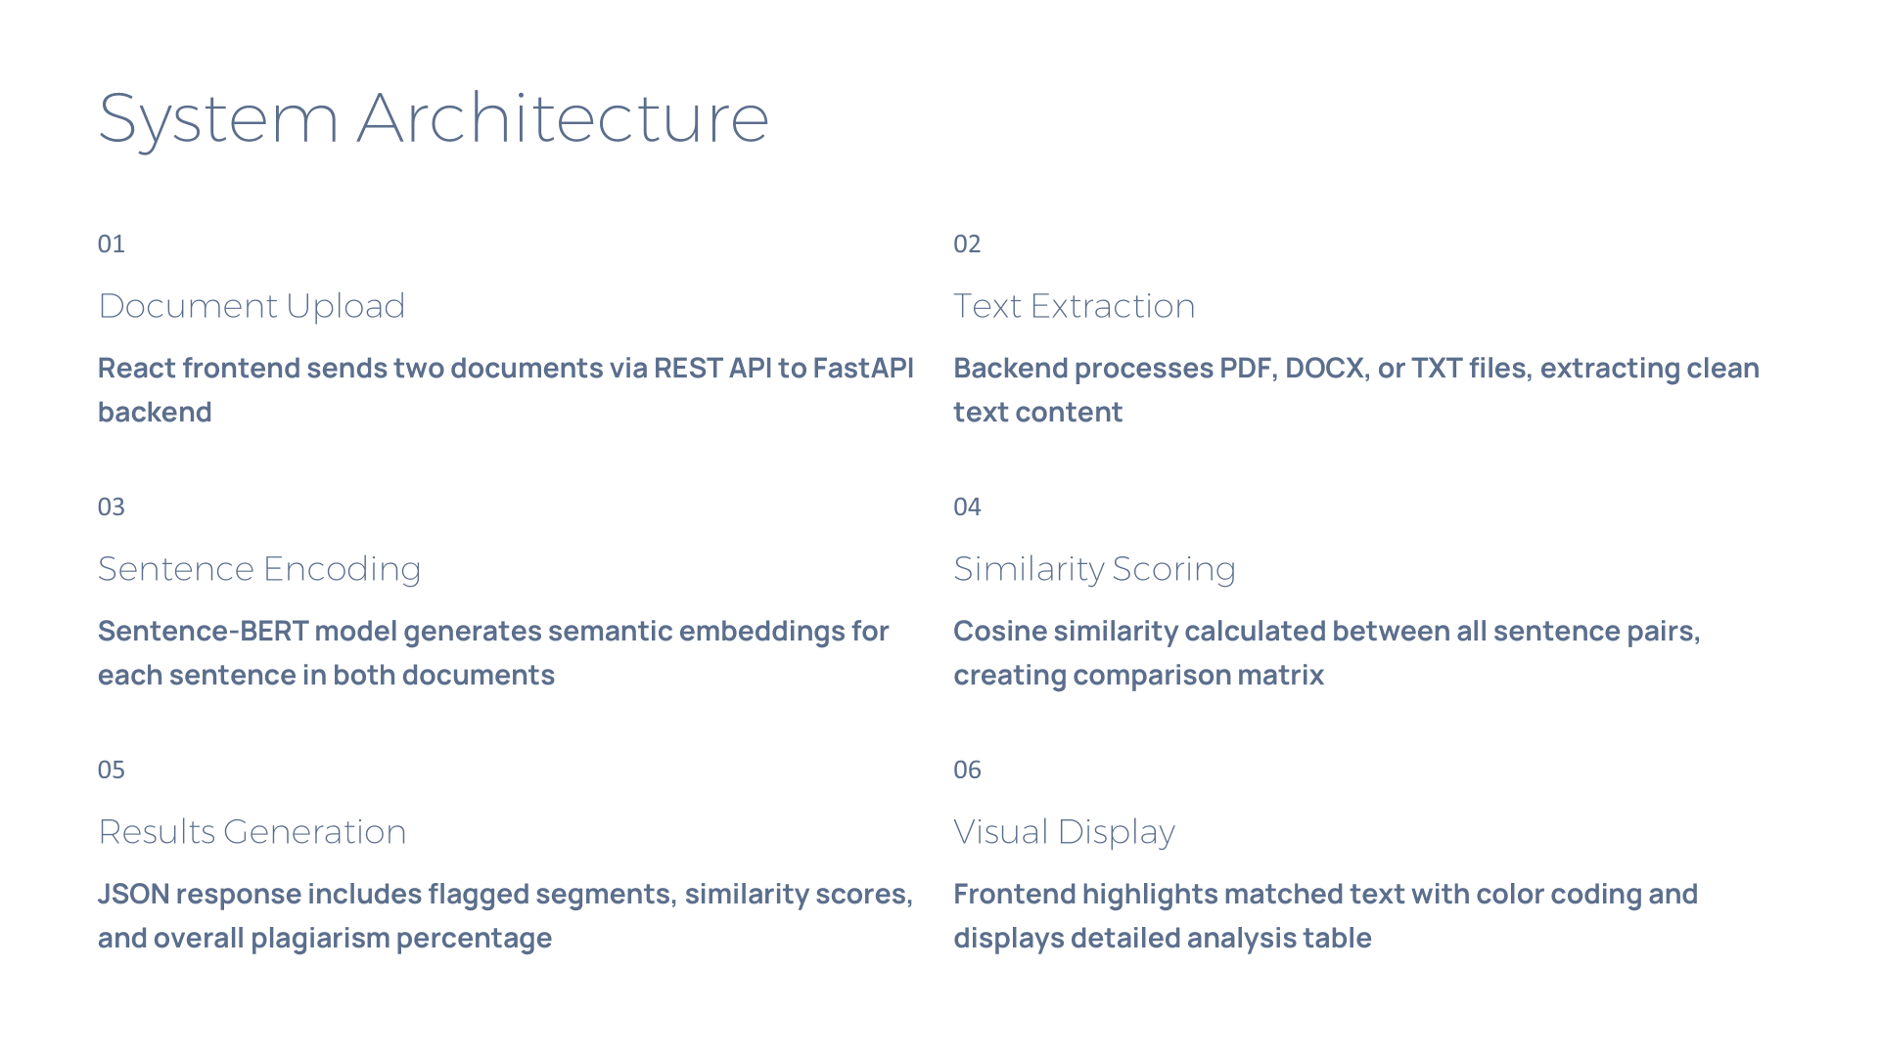
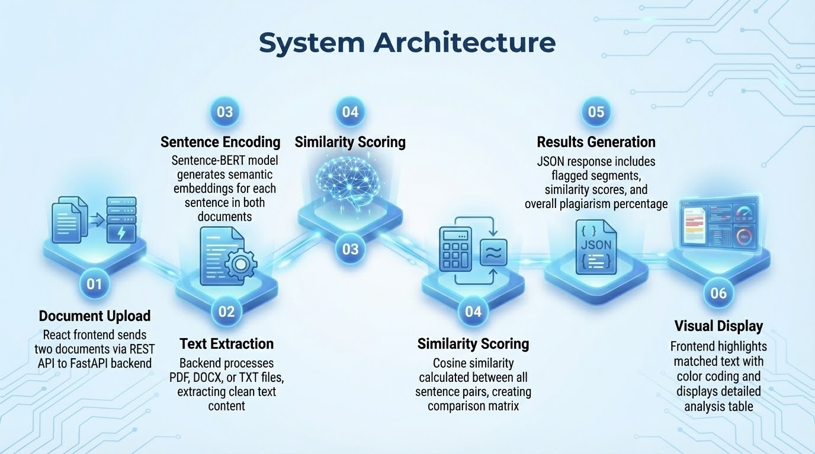

Slide 7
Detection Model Logic
≥ 0.90
0.80 – 0.90
< 0.80
Exact Match
Paraphrased
Original Content
Direct copying detected
Semantic similarity found
Sufficiently unique
Highlighted in red
Highlighted in yellow
No highlighting applied
Cosine Similarity Formula
This mathematical approach measures the angle between two embedding vectors, producing a similarity score between 0 (completely different) and 1 (identical meaning). The threshold-based classification ensures accurate detection while minimizing false positives.

Slide 8

Implementation Challenges
PDF Extraction Inconsistencies
Formatting issues, tables, and multi-column layouts create text extraction challenges requiring robust parsing logic
Sentence Splitting Accuracy
Abbreviations, decimal numbers, and special punctuation complicate proper sentence boundary detection
Model Inference Time
Large documents with hundreds of sentences require optimization to maintain reasonable processing speeds
Short Sentence Handling
Very brief sentences or fragments produce less reliable embeddings, affecting similarity accuracy
Threshold Calibration
Balancing sensitivity to catch paraphrasing while avoiding false positives requires careful threshold tuning

Slide 9
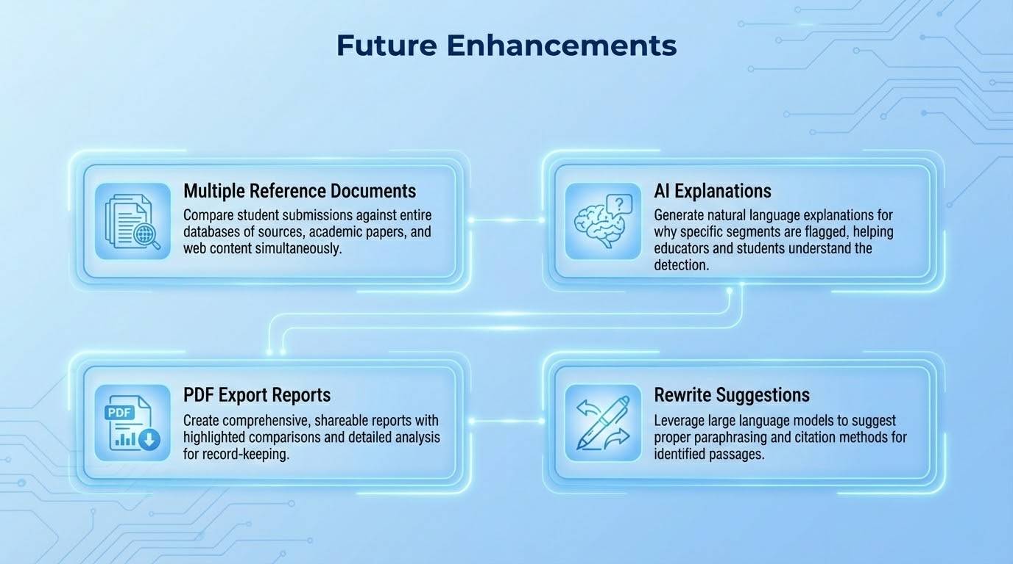

Slide 10







Key Takeaways
Semantic Detection
Robust Integration
Successfully built an AI system that identifies paraphrased content better than traditional keyword-matching approaches
Achieved seamless backend-frontend architecture with FastAPI, React, and Sentence-BERT working in harmony
Strong Foundation
Created a scalable platform ready for expansion into a comprehensive academic integrity solution
Thank You
Questions & Discussion

